Slide 1
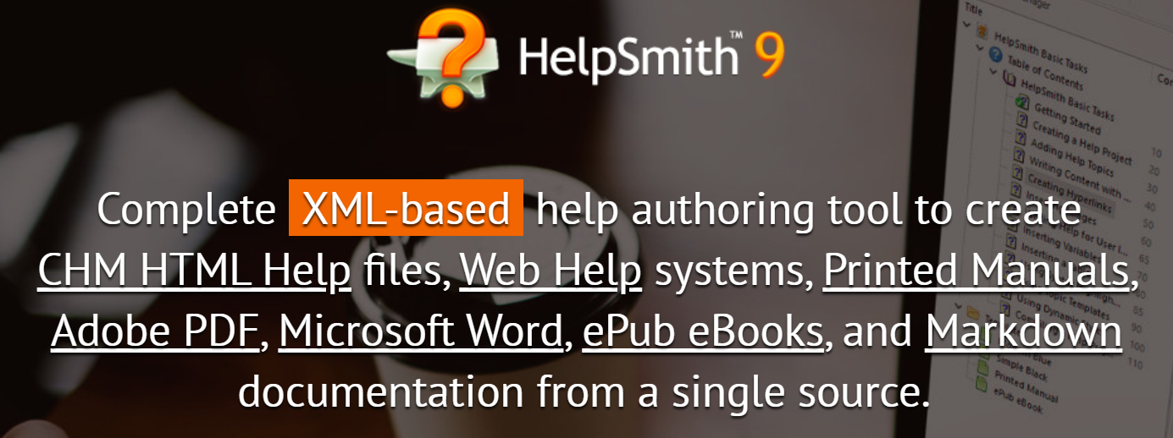
Using HelpSmith to create help files for PLCNext projects & function blocks.

Slide 2
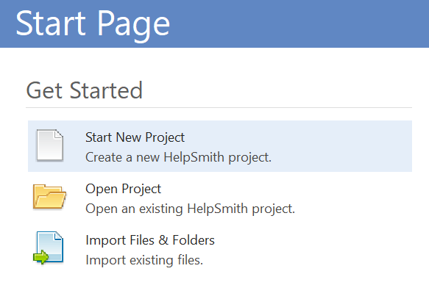
Step 1: Start New Project

Slide 3
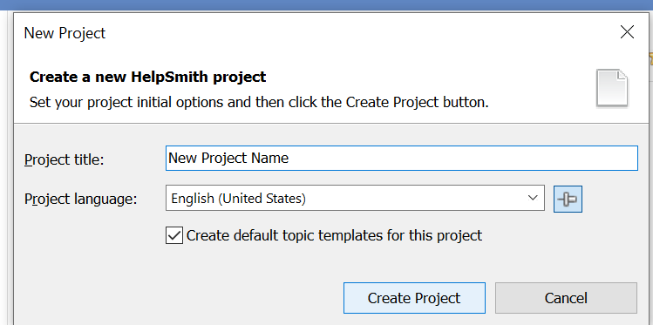
Step 1: Start New Project

Slide 4
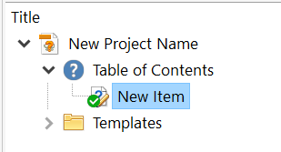
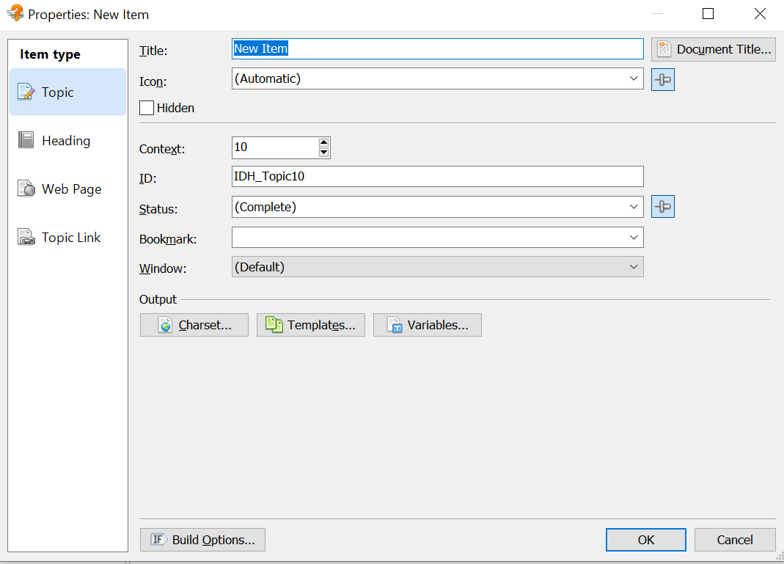
Step 2: Add new documents

Slide 5
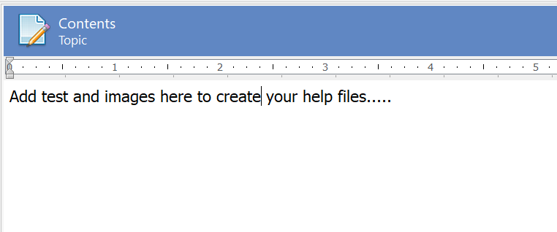
Step 3: Enter help file text

Slide 6
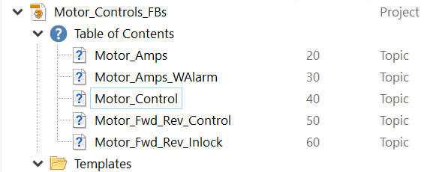
Step 4:Add additional pages as needed.

Slide 7

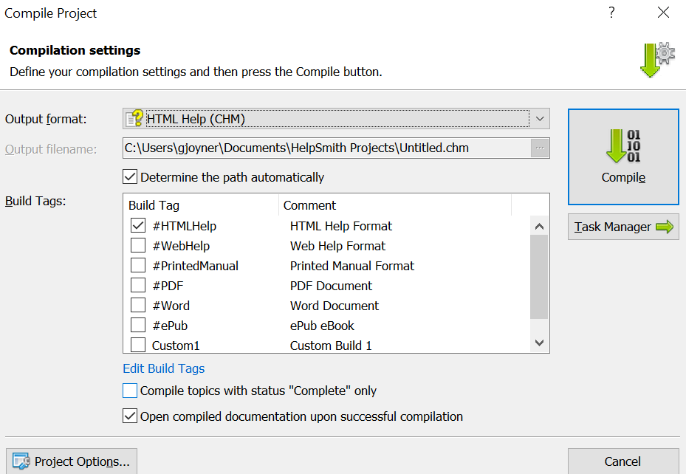
Step 5: Select Complie tab and select type of file to create.

Slide 8
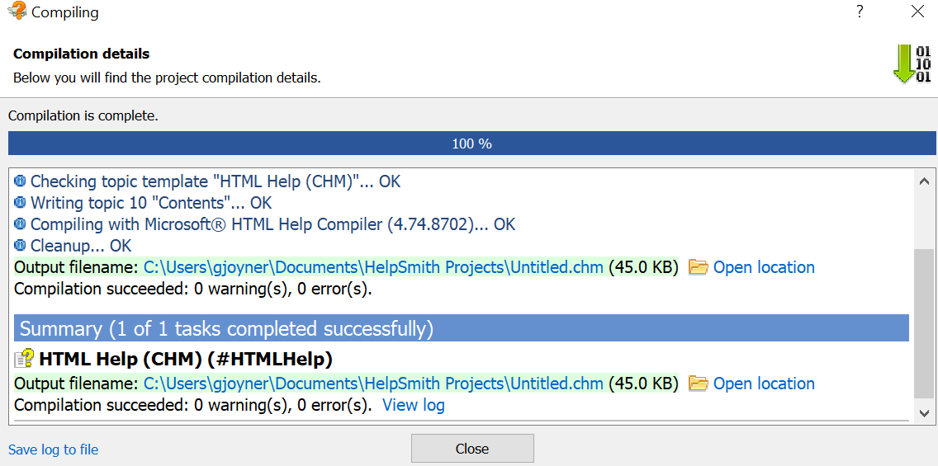
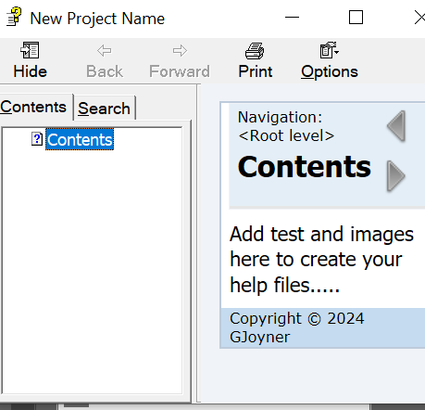
Step 6: Select See compile details for file location. Also see help file that opens & check for errors.

Slide 9
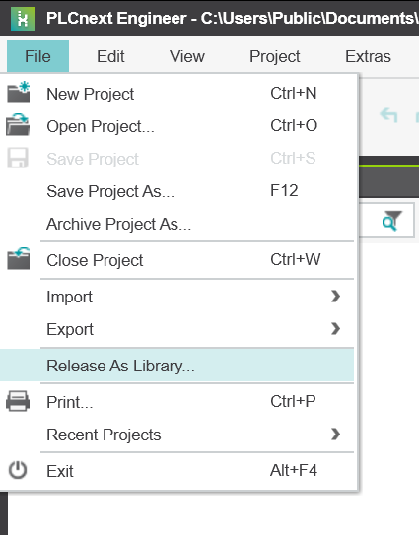
Step 7: In your PLCNext project select release as library.

Slide 10
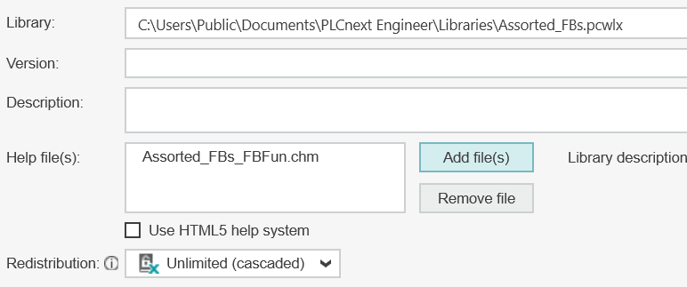
Step 8: Add files created in Helpsmith to your Help Files list as shown below. Select “release” tab on bottom right.
Note: Name of project & help file name must be the same adding ”FBFun” to help file name. Ext will be as shown.

Slide 11
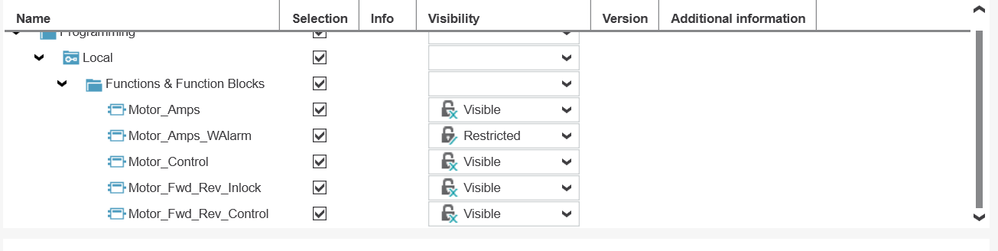
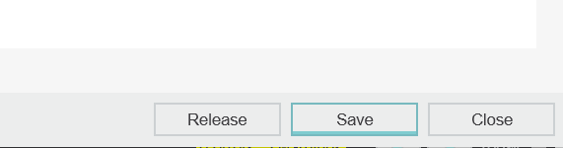
Step 9: Select parts of project to release & select visibility. Select “release” when ready to save library.

Slide 12
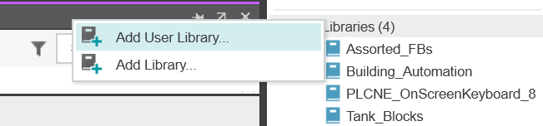
Step 10: Add User library to PLCNext project. Right click FB for help file.

Slide 13
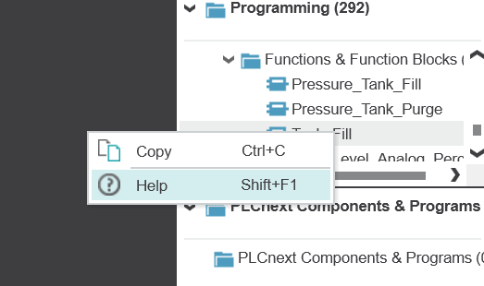
Step 11: Right click FB for help file.

Slide 14
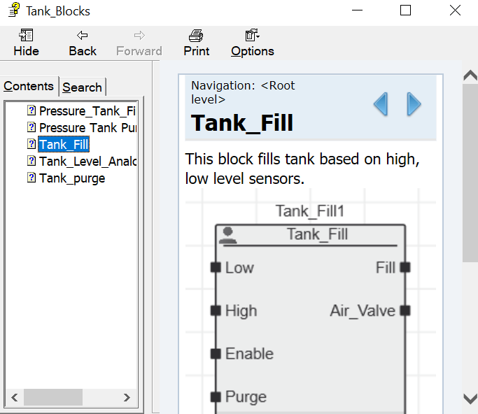
Step 12: Help file should open as shown below..

